Slide 1
Home Owl
Autonomous Security Robot
Samantha Buckle
Dylan Dauz
Sameeh Olipani
Sheldon Peters

Slide 2
Project Recap
This project aims to design and build a robot for use in the monitoring of indoor spaces
Robot will be capable of:
Autonomous movement
Navigation of a building or room without the need for human control
Utilize sensors to detect loud noises or the presence of a person
Flash lights and play an alarm sound when disturbance is detected
Get signal from remote control to turn the system on and off

Slide 3
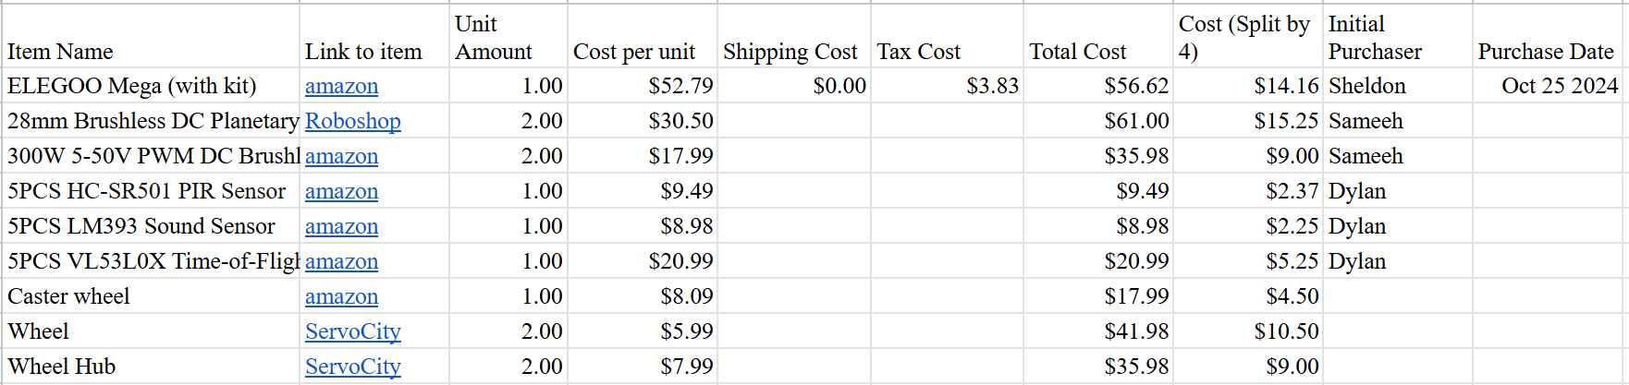
Parts list

Slide 4
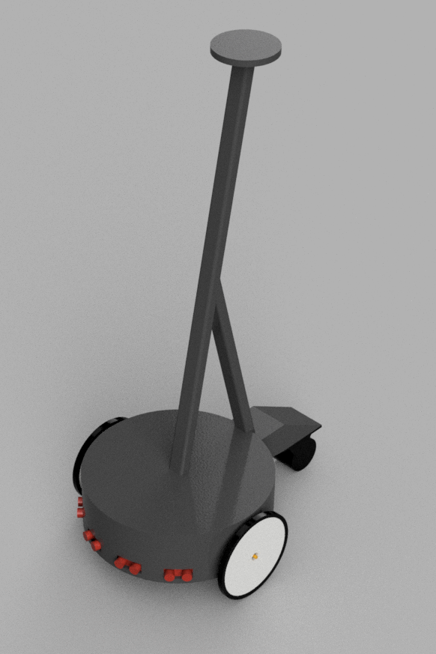
Concept Design

Slide 5

Concept Design

Slide 6
Next Steps
Order parts
Safety trainings for lab access / 3D printing access
Refine / finalize design

